Slide 1
Application of network flow: Protecting coral reef ecosystems

Slide 2
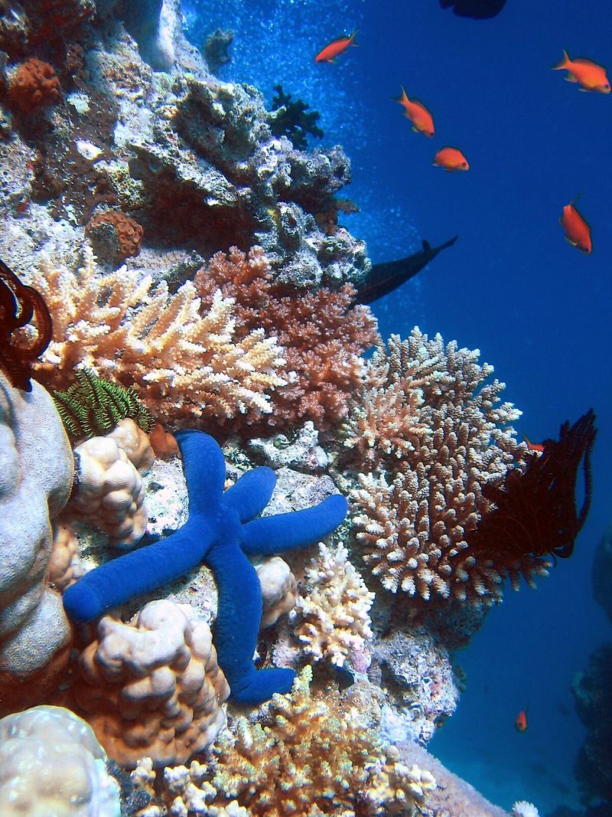
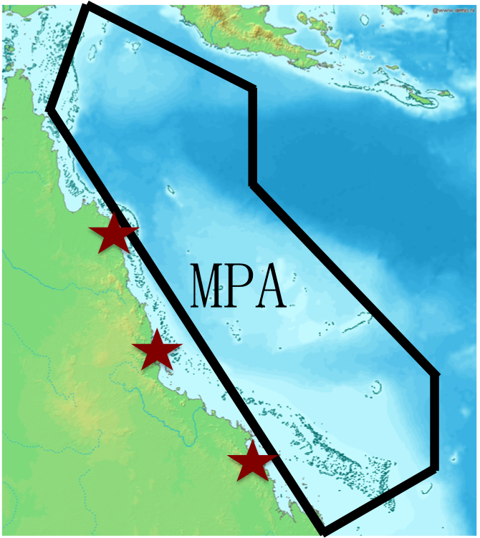
Coral Reef Ecosystems
Coral reef ecosystems
The Great Barrier Reef Marine Park
Coral reefs are threatened by human activities
Marine protected areas (MPAs) are built to protect them

Slide 3
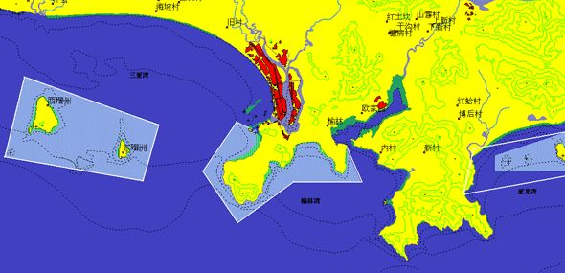
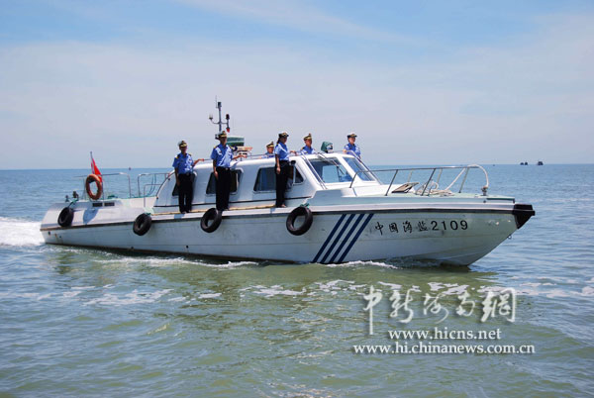
Challenges in Patrolling MPA
Limited resources v.s. Large open water
e.g.,Yalongwan MPA, 3 patrol boats v.s. 85km²
30m
85km²

Slide 4
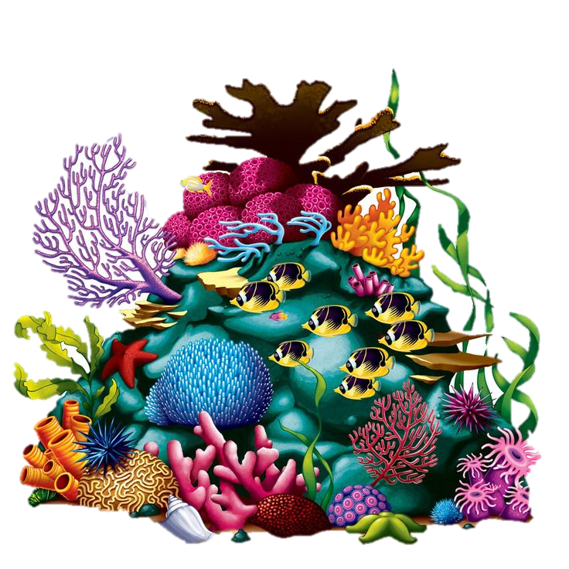
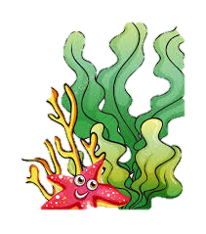

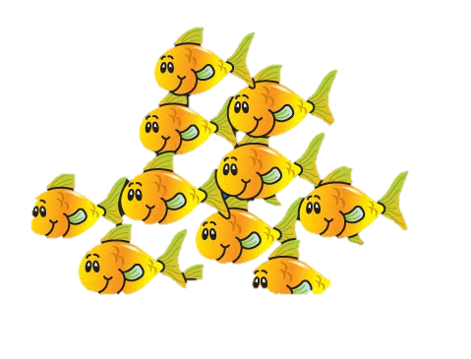
Challenges in Patrolling MPA
Limited resources v.s. Large open water
e.g.,Yalongwan MPA, 3 patrol boats v.s. 85km²
Dynamic value of different zones
Different zones have different values
Value of a zone changes over time

Slide 5
Challenges in Patrolling MPA
Limited resources v.s. Large open water
e.g.,Yalongwan MPA, 3 patrol boats v.s. 85km²
Dynamic value of different zones
Different zones have different values
Value of a zone changes over time
Notes:
When the marine creatures move, values of zones change.

Slide 6
Challenges in Patrolling MPA
Limited resources v.s. Large open water
e.g.,Yalongwan MPA, 3 patrol boats v.s. 85km²
Dynamic value of different zones
Different zones have different values
Value of a zone changes over time
Complicated strategy space
Defender strategy: time and path to patrol
Attacker strategy: time and path to get to the target zone, time duration of attack in the target zone
Strategic attacker
Observe,analyze, and respond

Slide 7
Challenges in Patrolling MPA
Limited resources v.s. Large open water
e.g.,Yalongwan MPA, 3 patrol boats v.s. 85km²
Dynamic value of different zones
Different zones have different values
Value of a zone changes over time
Complicated strategy space
Time, path, durations
Strategic attacker
Observe,analyze, and respond
Problem: How to design the most efficient patrol strategy?

Slide 8
Model: MPA graph
a
a
b
c
b
c
Marine protected area
MPA graph
Each node in the MPA is a potential attack target

Slide 9
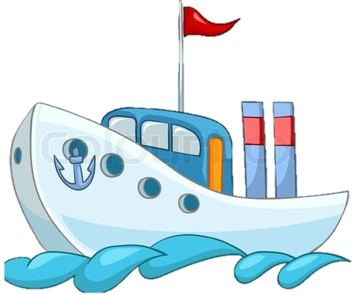
Model: Transition graph
Time: <8am, 9am, 10am> ; Travel time between zones: 1hour
a
a,8
a,9
a,10
s
b,8
b,9
b,10
t
b
c
c,8
c,9
c,10
MPA graph
Transition graph
Defender’s mixed strategies: Net flow
(The probability of covering each edge)
Notes:
From MPA graph to transition graph, we have a better view of time-dependent paths and varying values of zones.
Assume that defender’s patrol begins at 8am and ends at 10am. Add a virtual starting zone and a virtual terminal zone, an s-t flow is a feasible patrol path. The above figure shows an example: patrol begins at 8am at zone a, the defender immediately travels from zone a to zone b at 8am, and arrives at zone b at 9am. Then the defender stays at zone b and patrols this zone during 9am and 10am.
Assume that the defender has m resources, a pure strategy of the defender includes m patrol paths. A mixed strategy of the defender is a distribution over pure strategies, i.e., the probability that each pure strategy (m patrol paths) is used. We can prove that a mixed strategy of the defender is equivalent to an m-unit s-t fractional flow. The flow coverage on each edge indicates the expected number of resources on this edge.

Slide 10

Model: Payoffs
Each edge has:
A detection factor, probability that the attacker is detected by the defender if they are at the same zone during the same period
Each horizontal edge also has:
Probability of being caught:
0.2*0.3 + 0.3*0.4 =0.18
A value, damage caused by attacking a zone in a period
a,8
a,9
a,10
Attacker’s payoff:
5*(1 – 0.18) = 4.1
cov: 0.3
dec: 0.4
val: 5
b,8
b,9
b,10
cov: 0.2
dec: 0.3
Defender’s payoff:
-4.1
c,8
c,9
c,10
Notes:
For the attacker, any path in the graph is a feasible attack path. However, since the attacker needs to stay in a zone to perform illegal activities, only paths ending with horizontal edges can lead to positive utilities. Given a defender’s mixed strategy and an attacker’s pure strategy, the utility of the attacker depends on the probability that the attacker is caught, and the value of the attacker’s activities.
Given a mixed strategy of the defender, which corresponds to a network flow as is shown by ‘cov’ in the figure. Also given an attack path, we can compute the expected utility of the attacker and the defender. We assume that the probability of being caught is the sum of the probability of being caught on every edge of the attacker’s path (capped by 1). This is only an approximation to simplify the computation.

Slide 11
Computing the equilibrium
Defender commits to a mixed strategy first
c = <c_{e}>, the expected number of resources on edge e
Attacker knows the defender’s mixed strategy and responds the best
The attacker’s best response is always a pure strategy, i.e., a path
Y is any feasible attacker strategy. This inequality ensures that the attacker chooses he best response given the defender’s mixed strategy c. Together with the objective, we compute the optimal defender strategy given the attacker’s best response.
m-unit s-t fractional flow
Notes:
U(Y) is the sum of the values of the ending horizontal edges of path Y.
f_e is the detection factor of an edge.

Slide 12
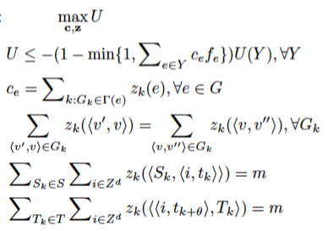
Expand the model
Constraints
Starting zones and ending zones of paths
Maximum continuous patrol time
Solutions
More virtual starting points and ending points
Maximum path length

